Slide 1
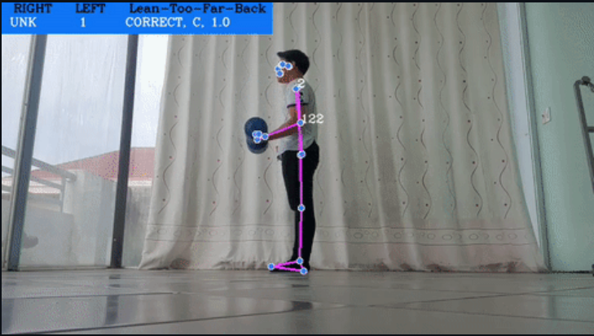
AI-Powered Exercise Form Correction
Helping users perform exercises correctly with real-time AI feedback.
Ashmit Rana(E23CSEU1049)
Devansh Saini(E23CSEU1050)
Rohan Bhati(E23CSEU1033)

Slide 2
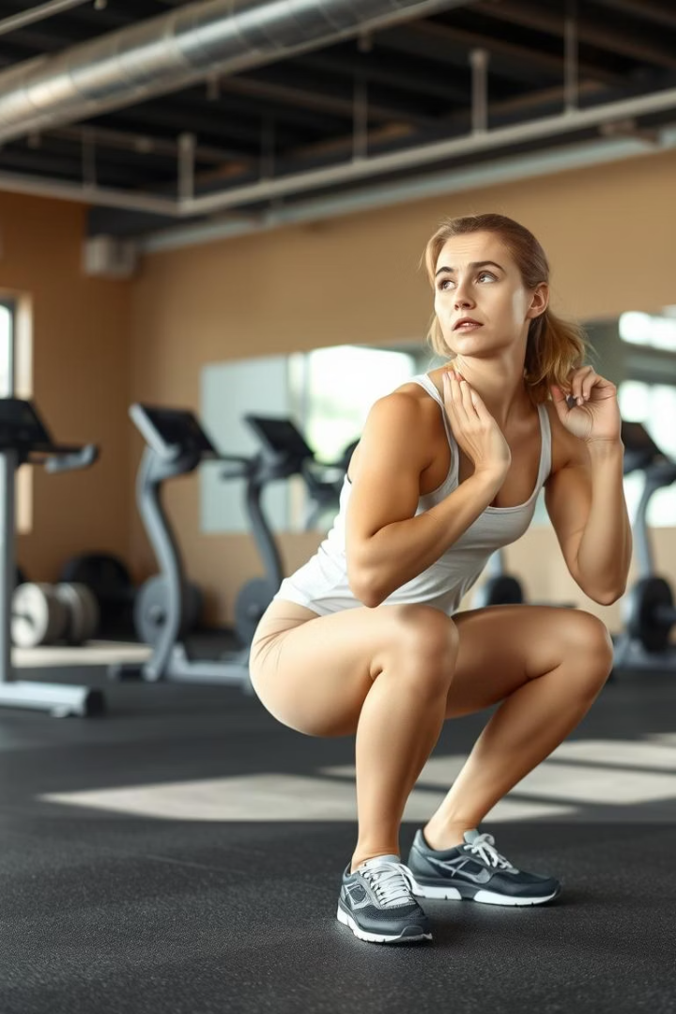
Problem Statement
Injury Risk
Personal Trainer Cost
Incorrect form often causes muscle and joint injuries.
Affordable and accessible personal training is limited.
Need for Automation
Automated tools can provide consistent exercise form correction.

Slide 3
Technology Stack
Pose Detection
Backend & Data
Frontend & Deployment
MediaPipe extracts 33 key body landmarks in real-time.
Python with scikit-learn for ML models
Vue.js for user interface
Docker containerizes the app
Pandas for data processing
Django handles backend API

Slide 4
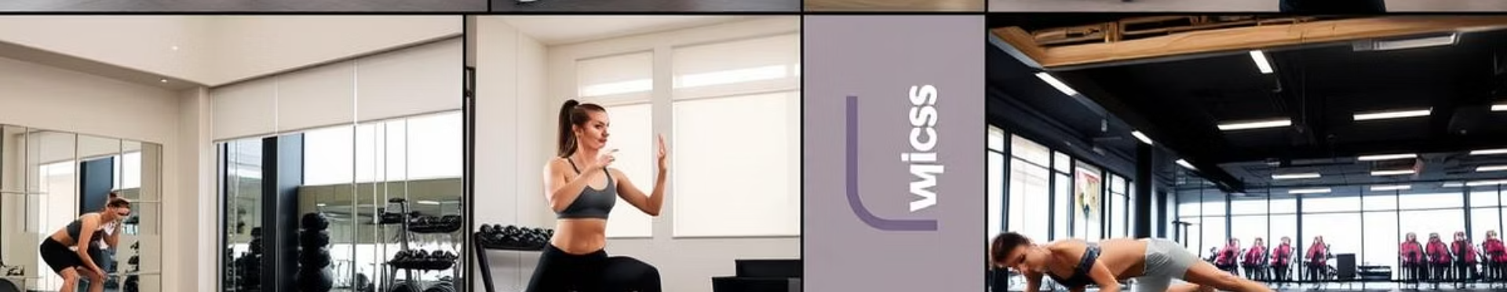
Exercise Dataset
Self-Collected Videos
Kaggle Yoga Dataset
Recorded majority of workouts to capture diverse forms.
Used for Plank pose to augment training data.

Slide 5
Exercises & Detection Focus
Bicep Curl
Squat
Plank
Lunge
Detects improper lean back during curls.
Analyzes depth and identifies squat phases.
Detects sagging and overall form alignment.
Checks if the knee crosses over the toe improperly.

Slide 6

Model Training & Evaluation
1
Landmark Extraction
33 keypoints per frame used as input features.
2
Classifier Training
Custom models trained per exercise type.
3
Performance Metrics
Evaluated using confusion matrix and ROC curves.

Slide 7
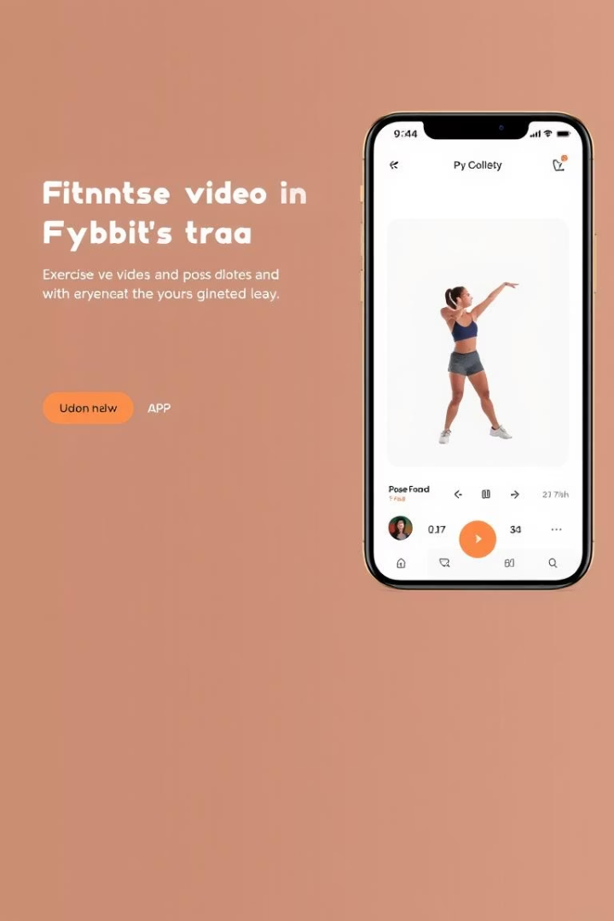



Web App Demo
Video Upload
Users upload workout videos easily.
Pose Analysis
Real-time pose overlay shows body landmarks.
Feedback
Clear, actionable corrections guide users.

Slide 8
Results, Limitations & Future
Results
Limitations
Future Work
High accuracy in form classification
Dataset needs more diversity
Add direct camera feedback
Currently no real-time camera integration
Expand exercise types covered
Reliable real-time feedback
Improve model robustness

